Slide 1
Dictionaries and Hash Tables
CS 580U Fall 2017

Slide 2
Dictionaries

Slide 3
Problem
You have been asked by a VOIP company to write some software that implements a caller id by IP address. Given an IP address, return the caller’s name:
ip_address => name
IP addresses are unique, however, not all IP addresses are in use. How can we store and look up IP/name pairs?

Slide 4
Dictionary
A Dictionary is an ADT that is indexed by Key/Value pairs
The Dictionary ADT insists that every comparable index must be unique (i.e., no duplicates).
This is achieved through index keys
Keys must be unique
Keys must be comparable
Arrays are dictionaries that use the element index as a key
Dictionary's values are "just along for the ride"

Slide 5
CRUD
Insert: Keys are traditionally kept in sorted order, but not necessarily
Python dictionary keeps keys in random order
Find: allows quick searching of elements
If elements are sorted, improves search time
Iterator
Iterators are important for dictionaries because a user could not get a record of the dictionary that she didn't already know the key for.

Slide 6
Tradeoffs
No traversal
Dictionary, like the stack and queue, is a secondary data structure
Uses another internal data structure, only adding behavior to it
Underlying data structures have pros and cons
List implementation is slow for search
Array Implementation is slow for insert and delete
Can use an extra array to speed up deletion at the cost of memory and complexity
Tree is okay for both, but without constant rebalancing you lose the benefits of a tree

Slide 7
Hash Tables

Slide 8
Dictionary
Dynamic data structure for storing items indexed using keys.
Dictionaries define access, not implementation
How can we implement a Dictionary?
Simplest way
As 2 collections
one for keys
one for values
A collection of pair objects
Iterate through to find the key
These solutions grow in time as the data set grows

Slide 9
Another Solution
What if we need nearly instant access?
For example, 911 requires nearly instant lookup for caller ID
Hash Table
A hash table is a generalization of ordinary arrays.
Arrays are Direct Access Tables
Element whose key, k, is obtained by indexing into the kth position of the array.
Perfect for when we can afford to allocate an array with one position for every possible key.
i.e. when the possible keys is a limited set.

Slide 10
Hash Table
Universe of all possible keys (U) is the number of possible keys in the array
What is U for a standard array? - limited by memory
What is the U for an alphabet based index (26)?
Set of keys (K) actually stored in the dictionary.
|K| = n.
The number of keys is the current size of the array
What about when U is very large? Arrays are not practical.
As seen with the caller ID problem, array would result in a lot of wasted space

Slide 11
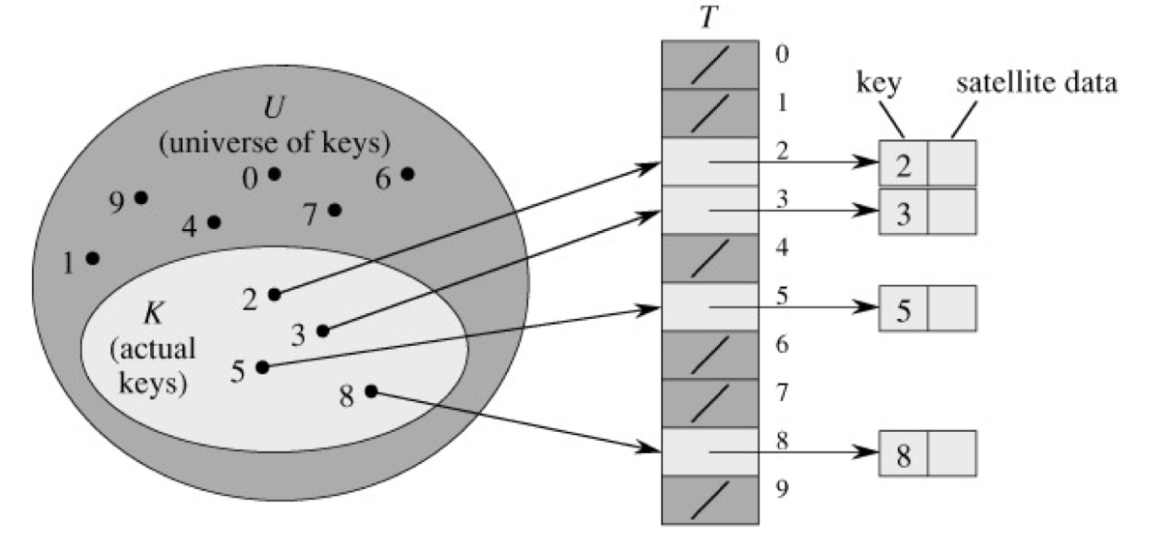

Slide 12
Problem with Direct Access Tables
Direct addressing works well when the range m of keys is relatively small, but what if the keys are 32-bit integers, such as an IP address?
Problem1: direct-address table could have only several thousand entries, but more than 4 billion ‘spaces’
Problem 2: even if memory is not an issue, the time to initialize the elements to NULL may be prohibitive
Solution: map keys to smaller range
We need only store the number of actual keys rather than space for all possible keys.

Slide 13
Hash Function
Let’s use a collection of size proportional to |K| (the actual number of keys)
However, now we lose the direct-addressing ability.
Solutions? Hash Function
Define function that performs a transformation on the key that map keys from U to a slot within the hash table.
Arrays vs Hash Tables
With arrays, key k maps to slot A[k].
With hash tables, key k maps or “hashes” to slot A[h(k)].
h(k) is the hash value of key k.

Slide 14
Classwork
int hashFunction(int phone_num){
return phone_num % size_of_hash_table;
}
Heap
Linked List
Hash
Balanced Binary Search Tree
Hash Function

Slide 15
Common Hashing Function
Using simple division is a common hashing technique that works on many kinds of data
Mod: Map a key, k, into one of the m slots by taking the remainder of k divided by m. That is,
h(k) = k mod m
where k is the key and m is the size of the table
Example: m = 31 and k = 78 h(k) = 16.
Square Median: Square the key, then take the middle two values
Example: 45² = 2025 = hashes to 02

Slide 16
Collisions
Assume we have the following hash function
index = key % 31
both 91 and 65 hash to 2
Multiple keys can hash to the same slot
When two keys hash to the same location this is called a collision
Hash functions should be designed such that collisions are minimized
However, avoiding collisions is impossible.

Slide 17
Likelihood of Collisions
What is the likelihood of collisions?
Everyone should go around the room and say their birthday
If someone says your birthday before you do, raise your hand
With a K of size 23, and a U of 365, there is a 50% chance of a collision
This problem illustrates the likelihood of collisions and the impossibility of creating a hash function that does not result in collisions
Given an distributed data set
Notes:
?

Slide 18
Classwork
Solving Collisions

Slide 19
Resizing on Collisions
We could, whenever there is a collision, resize the entire table to eliminate the collision
Heuristic studies show that a table with the following properties results in the fewest collisions:
1.5-2 times the size of the set of K
Table size is a prime number
When we resize, we should find a prime number in the range 1.5-2 times the current size of the table
What problem can arise here?
Resizing the table can result in a new collision requiring a further resize

Slide 20
Collision Resolution: Open Addressing
Open Addressing stores only in the hash table itself.
When collisions occur, use a systematic (consistent) strategy to store elements in free slots of the table.
try alternate cells until empty cell is found.
Multiple strategies, for example:
Linear probing - Store on the next open slot
When searching for a value, start at the hashed slot, then keep searching until the value is found or an empty slot is encountered
Double Hashing - use a second hash function to determine the index on a collision
Items that hash to the same initial location will have a different probe sequence

Slide 21
Problems with Open Addressing
Open Addressing sacrifices lookup time and complexity for memory efficiency
If a table is full, lookup time could be O(n)
Basically an unsorted array
What happens if you allow deletion
You may stop prematurely on deletion
The only solution is to have different markers for empty and deleted
Eventually, as objects get added and deleted, we will have to search the entire table

Slide 22
More Problems with Open Addressing
Open addressing compounds the problem of collisions
As you place elements in ‘slots’ they don’t belong in, what happens when an object that does belong there gets inserted?
As your hash table grows, more and more objects are in the ‘wrong’ locations
You begin losing the benefits of a hash table
Open Addressing is useful when
Few or no deletions
Few collisions
Memory is expensive

Slide 23
Collision Resolution: Chaining
The hash table is an array of linked lists
Store all elements that hash to the same slot in a linked list.
Store a pointer to the head of the linked list in the hash table slot.
Notes:
As before, elements would be associated with the keys
We’re still using the hash function h(k) = k mod m
0
81
1
1
2
22
3
63
23
4
5
95

Slide 24
Problems with Chaining
If data clusters, then we lose the benefits of a hash table.
Our original requirement was constant time, or near constant time access
We are also using much more memory
The reason we chose a hash table in the first place is because we wanted to use less memory
Additional logic complexity
Overhead required for linked list

Slide 25
Classwork
Chaining
Linear
Double Hashing
44
12
36
26
5
40
42
44
12
80
36
26
5
92
59
40
42
60
44
12
60
40
26
5
36
59
11
42
80
80
92
59
60
Resizing The Hash Table
h2(i) = (i*2) % table_size

Slide 26
The Importance of a good Hash Function
A Hash Function should satisfy the assumption of simple uniform hashing.
A hashing function should aim to distribute items in the hash table evenly.
An item to be hashed should have equal probability of going into any slot
if your hash function doubles the value, then takes the last 2 numbers, you will never place a value in an odd slot
Not possible to satisfy the assumption in practice.
Often use heuristics, based on the key domain, to create a hash function
Hash value should not depend on patterns that might exist in the data
data changes

